Slide 1


<Name>
<Date>

Slide 2

Outline
Executive Summary
Introduction
Methodology
Results
Conclusion

Slide 3
Executive Summary
Summary of methodologies
Data Collection using API
Data Collection with web scraping
Data Wrangling
Exploratory Data Analysis with SQL
Exploratory Data Analysis with Data Visualisation
Interactive Visual Analytics with Folium
Machine learning Prediction
Summary of all results

Slide 4
Introduction
Capstone project to take the role of a data scientist
I’ll built a machine learning model with the use of public information to predict the successful landing of SpaceX rockets

Slide 5

Section 1

Slide 6
Methodology
Executive Summary
Data collection methodology:
By scraping data from a static URL of a Wikipedia page that list all Falcon 9 and Falcon Heavy launches. Python and the request library is used to fetch the webpage content, and then used BeautifulSoup to parse the HTML content and extract the required information.
Additionally, another portion of the data is collected from a static JSON file using a an API Call. The JSON containing information about the rockets, payloads, launchpads, cores, flight number and data.
Perform data wrangling
Calculated Numer of Launches on each site, calculated number of occurrences of each orbit, calculated the number of occurrence of mission outcome, and created a landing outcome label.
Perform exploratory data analysis (EDA) using visualization and SQL
Perform interactive visual analytics using Folium and Plotly Dash
Perform predictive analysis using classification models
How to build, tune, evaluate classification models

Slide 7
Data Collection
Data collected by web scraping data from the List of Falcon 9 and Falcon Heavy launches Wikipage
Data collected by HTTP request to SpaceX API
Web Scraping Wikipage
Start
Data Source Identification
Data Conversion
End
API Call (SpaceX API)

Slide 8
Data Collection – SpaceX API
Start
Flowchart overview of the data collection process through SpaceX API. Full notebook can be seen in URL below.
Github URL:
https://github.com/georn/ibm-applied-data-science-project/blob/master/DataCollection/jupyter-labs-spacex-data-collection-api.ipynb
Send GET request to SpaceX API using the request library
On successful request, parse the JSON response
Convert into a pandas DataFrame for easier manipulation and analysis
End

Slide 9
Data Collection - Web Scraping
Start
Flowchart overview of the data collection process through webscraping the Wikipage. Full notebook can be seen in URL below.
Github URL:
https://github.com/georn/ibm-applied-data-science-project/blob/master/DataCollection/jupyter-labs-webscraping.ipynb
Send GET request to Wikipedia page using the request library
On successful request, parse the HTML response
Extract the required data (Launch sites, payload, launch outcome) using BeautifulSoup library
Clean and structure the extracted data as needed (removing unnecessary characters, splitting columns, etc)
Convert the processed data into a pandas DataFrame for easier manipulation and analysis
End

Slide 10
Data Wrangling
Calculates the number on each site
Calculates the number of occurrences of each orbit
Calculate the number and occurrence of mission outcome per orbit type
Create a landing outcome label from Outcome column
Github URL
https://github.com/georn/ibm-applied-data-science-project/blob/master/SpaceX_Machine_Learning_Prediction_Part_5.jupyterlite.ipynb

Slide 11
EDA with Data Visualization
Charts:
Scatter Plot: Flight Number vs Payload Mass, Flight Number vs Launch Sites, Payfload vs Launch Sites, Payload vs Orbit Type
Bar Chart: Launch Success rate of each orbits
Line Plot: Launch Success rate vs Dates
Github URL
https://github.com/georn/ibm-applied-data-science-project/blob/master/Visualisations/jupyter-labs-eda-dataviz.ipynb

Slide 12
EDA with SQL
Displays the names of the unique launch sites
Display 5 records where launch sites begin with ‘CCA’
Display the total payload mass carried by boosters launched by NASA
Display average payload mass carried by booster F9 v1.1
List the date when the first successful landing outcome in ground was achieved
List of names of the boosters which have success in drone ship and have payload mass greater than 4000 but less than 6000
List of total number of successful and failure mission outcomes
List the names of the booster versions which have carried the maximum payload mass.
List the failed landing outcomes in drone ship and launch sites names for in year 2015
Rank the counting of landing outcomes
Github URL:
https://github.com/georn/ibm-applied-data-science-project/blob/master/dataWrangling/jupyter-labs-eda-sql-coursera_sqllite.ipynb

Slide 13
Build an Interactive Map with Folium
Folium markers were implemented to pinpoint SpaceX launch sites and their surrounding notable landmarks, which include railways, highways, cities, and coastlines. Polylines were utilized to establish connections between the launch sites and their closest landmarks.
A red coloration signifies instances of rocket launch failures.
Successes in rocket launches are represented by the color green.
Github URL
https://github.com/georn/ibm-applied-data-science-project/blob/master/VisualAnalyticsFolium/lab_jupyter_launch_site_location.ipynb

Slide 14
Build a Dashboard with Plotly Dash
Summarize what plots/graphs and interactions you have added to a dashboard
Explain why you added those plots and interactions
Add the GitHub URL of your completed Plotly Dash lab, as an external reference and peer-review purpose

Slide 15
Predictive Analysis (Classification)
Using Scikit-learn creating a machine learning pipeline to predict if the stage will land given data
Github URL
https://github.com/georn/ibm-applied-data-science-project/blob/master/PredictiveAnalysis/SpaceX_Machine_Learning_Prediction_Part_5.jupyterlite.ipynb

Slide 16
Results
It was shown that successful landing outcomes had increased since 2015
Launch sites located near the coast line and away from populated areas to easier test the rockets
Near highways and railways to help transportation of equipments and rocket pieces
Machine learning able to predict the succes of rockets with an accuracy score of 83.33%

Slide 17

Section 2

Slide 18
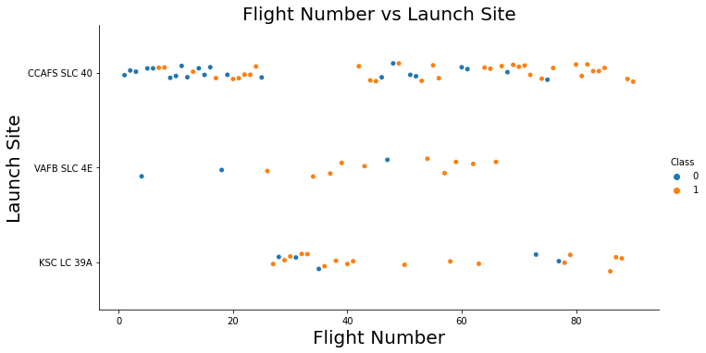
Flight Number vs. Launch Site
It seems that the number of successful landings grew in correlation with the increase in flight numbers. Notably, CCAFS SLC 40 was the launch site with the highest number of landings.

Slide 19
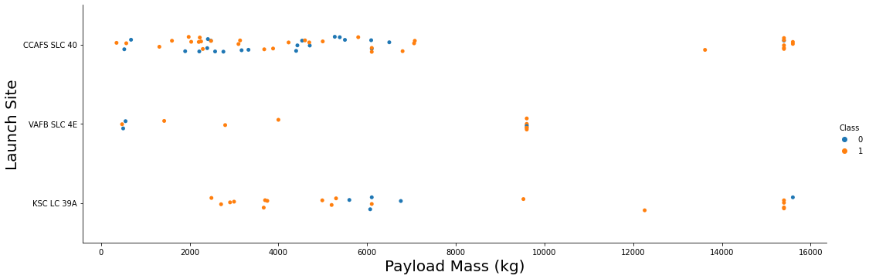
Payload vs. Launch Site
Upon examining the scatter point chart, it becomes apparent that for the VAFB-SLC launch site, there haven't been any rocket launches carrying a heavy payload mass exceeding 10,000 kg.

Slide 20
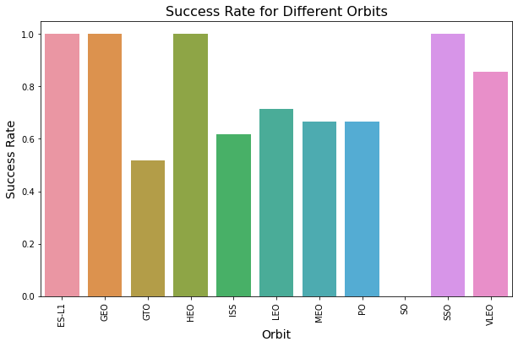
Success Rate vs. Orbit Type
The highest success rate Orbits are
- ES-L1
- GEO
- SSO
- HEO

Slide 21
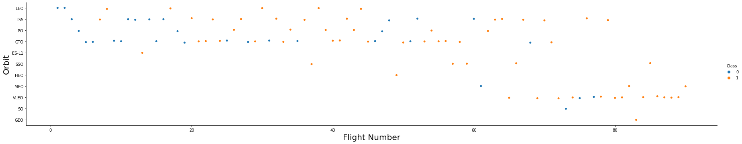
Flight Number vs. Orbit Type
It is evident that for the LEO orbit, success seems to correlate with the number of flights. However, no such relationship is apparent between flight number and success rate for GTO orbit.

Slide 22
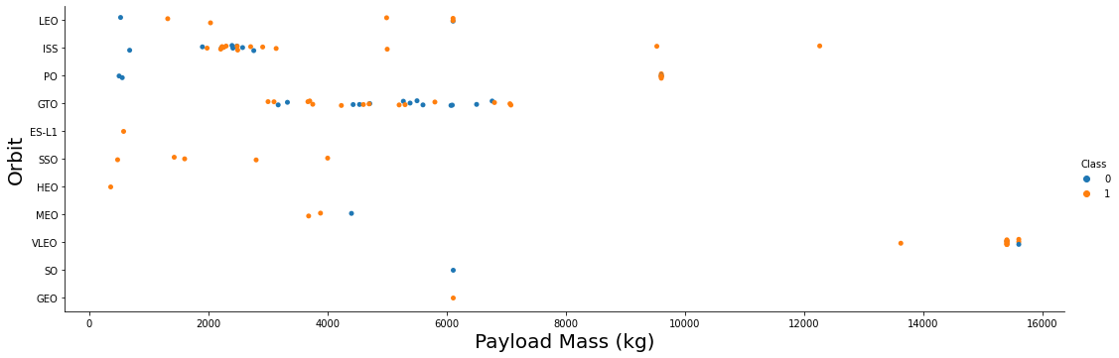
Payload vs. Orbit Type
For heavier payloads, the rate of successful or positive landings is higher for Polar LEO and ISS. Conversely, for GTO, it's harder to discern a pattern as both successful and unsuccessful missions are quite common.

Slide 23
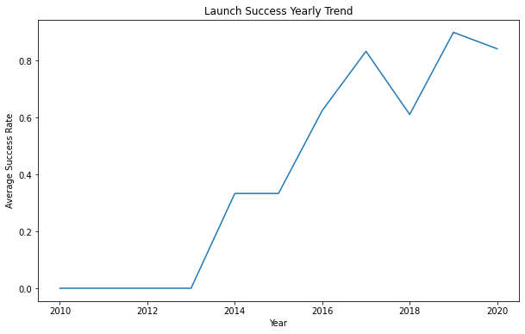
Launch Success Yearly Trend
It is shown that the success rate has significantly increased from 2013 to 2020

Slide 24
All Launch Site Names
All Launch Site Names
CCAFS LC-40
VAFB SLC-4E
KSC LC-39A
CCAFS SLC-40

Slide 25
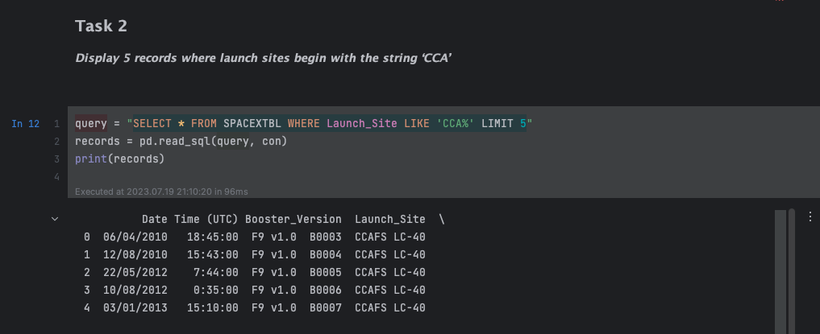
Launch Site Names Begin with 'CCA'
It is shown the 5 records where launch sites begin with letters ‘CCA’

Slide 26
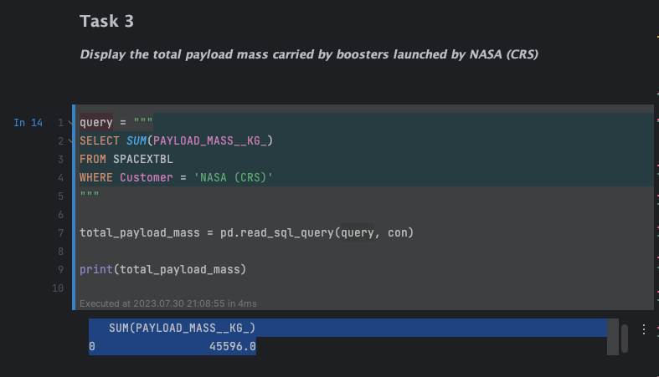
Total Payload Mass
It is shown that the total mass carried by Boosters launched by NASA

Slide 27
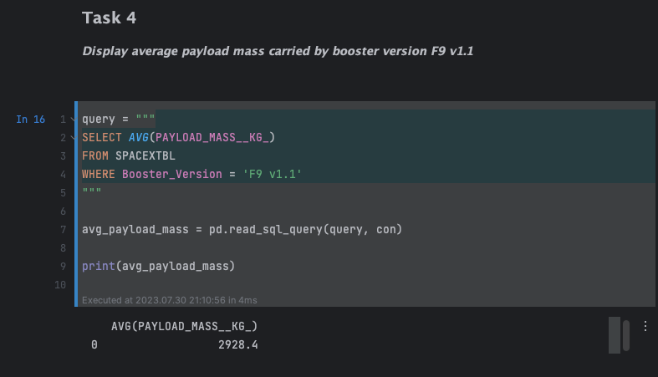
Average Payload Mass by F9 v1.1
It is shown the average payload mass carried by a F9 v1.1 was 2928.4

Slide 28
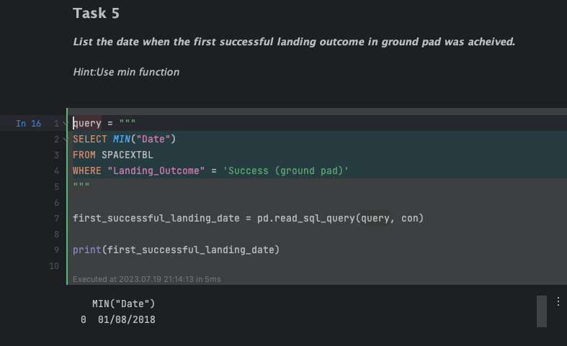
First Successful Ground Landing Date
From the result it says 01/08/2018

Slide 29
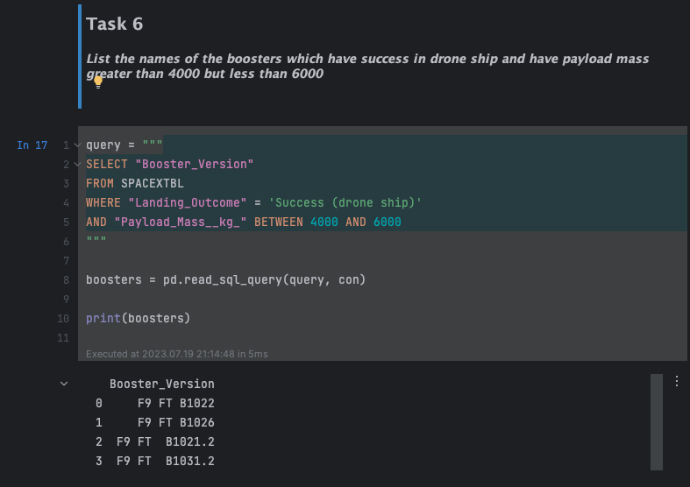
Successful Drone Ship Landing with Payload between 4000 and 6000
The only 4 boosters with payload mass between 4000kg and 6000kg

Slide 30
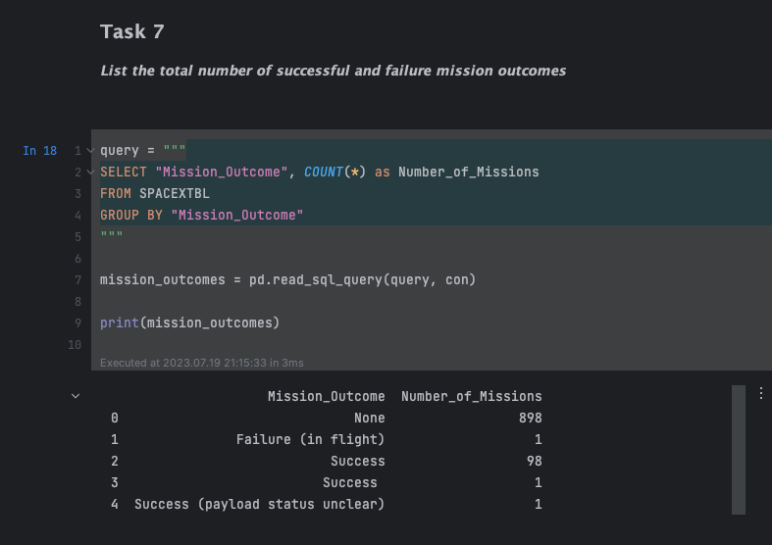
Total Number of Successful and Failure Mission Outcomes
It is shown the total number of successful and failure mission outcomes

Slide 31
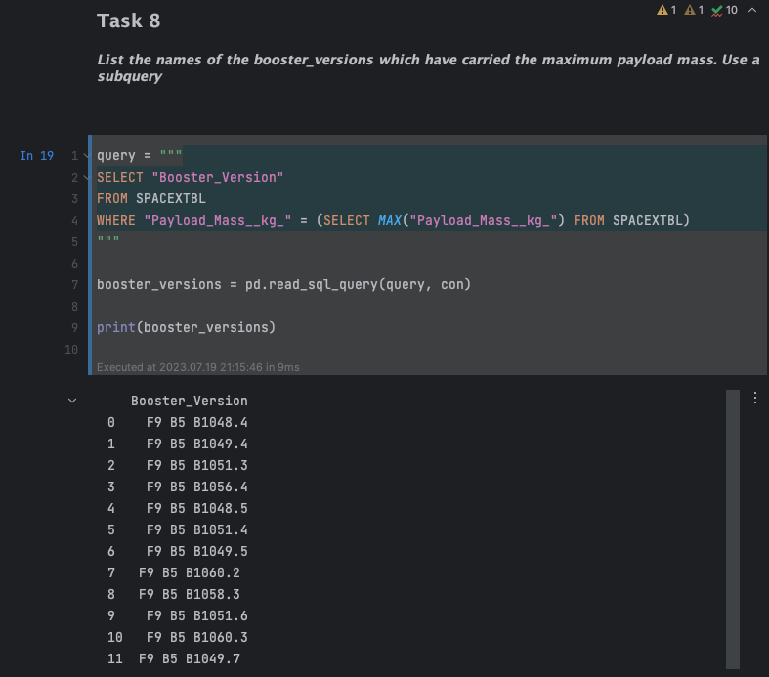
Boosters Carried Maximum Payload
It is shown that 12 boosters have carried the maximum payload mass.

Slide 32
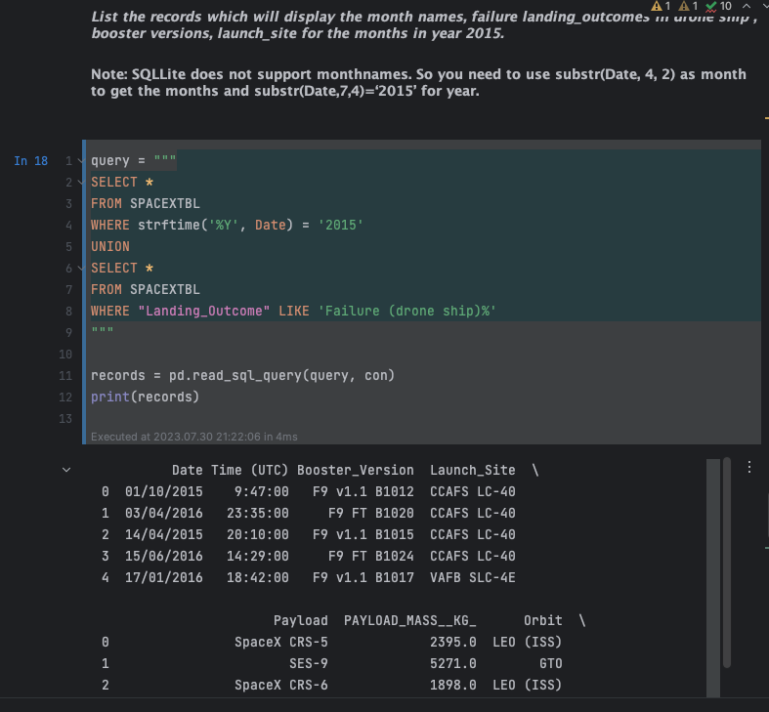
2015 Launch Records
Two boosters F9 v1.1 B1012 and F9 v1.1 01015 from CCAFS LC-40 failed to land at 2015

Slide 33
Rank Landing Outcomes Between 2010-06-04 and 2017-03-20
Rank the count of landing outcomes (such as Failure (drone ship) or Success (ground pad)) between the date 2010-06-04 and 2017-03-20, in descending order
Present your query result with a short explanation here

Slide 34

Section 3

Slide 35
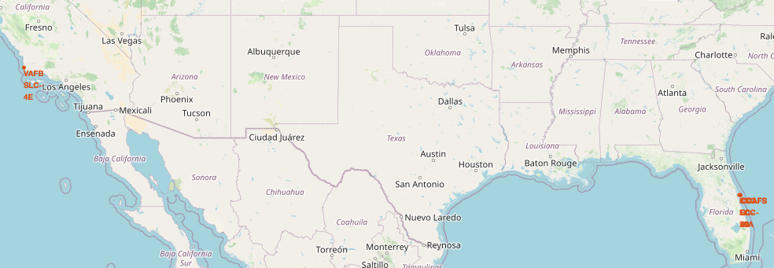
Launch sites Locations
Each launch site is located in close proximity to the coast and couple thousand kilometers away from the equator.

Slide 36
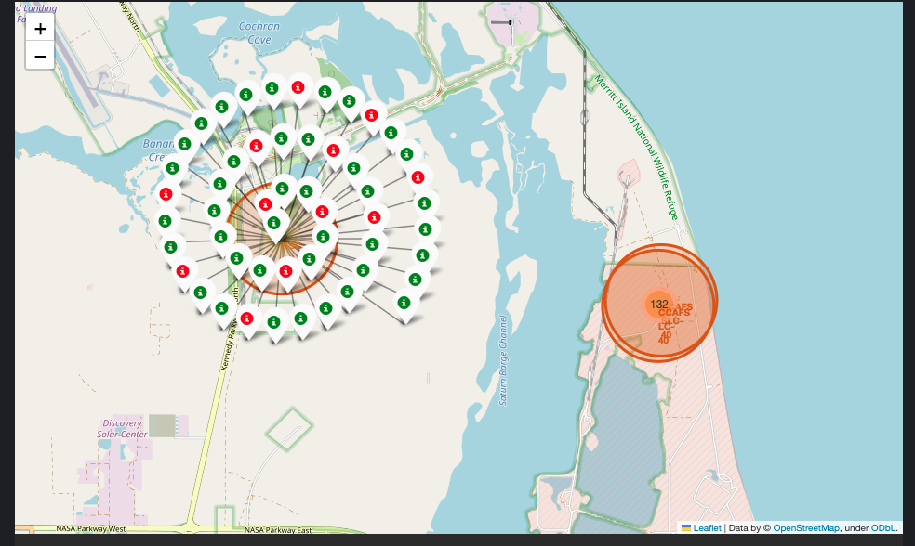
Success Rate of Rocket Launches
The green markers denote successful rocket launches, while the red markers indicate failed launches.

Slide 37
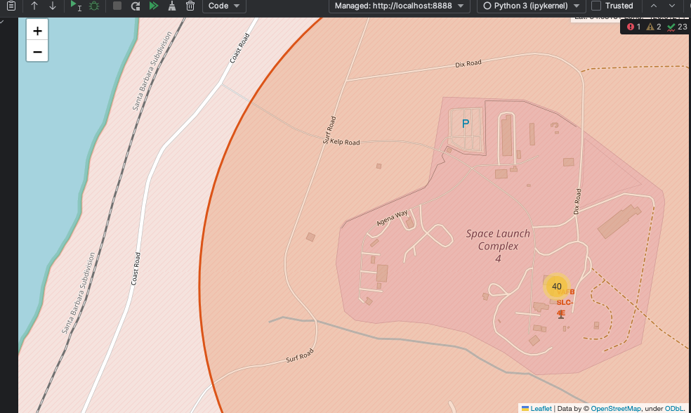
Surrounding Landmarks
It seems that launch sites are typically situated far from urban areas, with close proximity to railways and highways. They are also usually located near the coastline.

Slide 38

Section 4

Slide 39
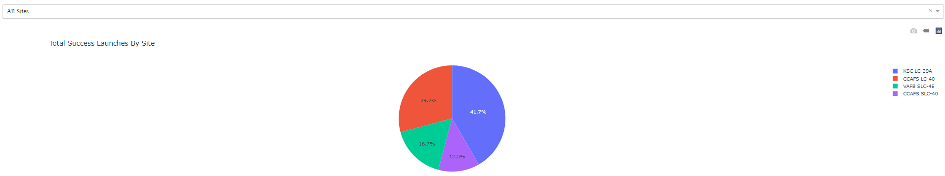
Successful Launches by Site
The plot illustrates that Site KSC LC-39A not only has the most successful launches but also boasts the highest rate of successful launches.

Slide 40
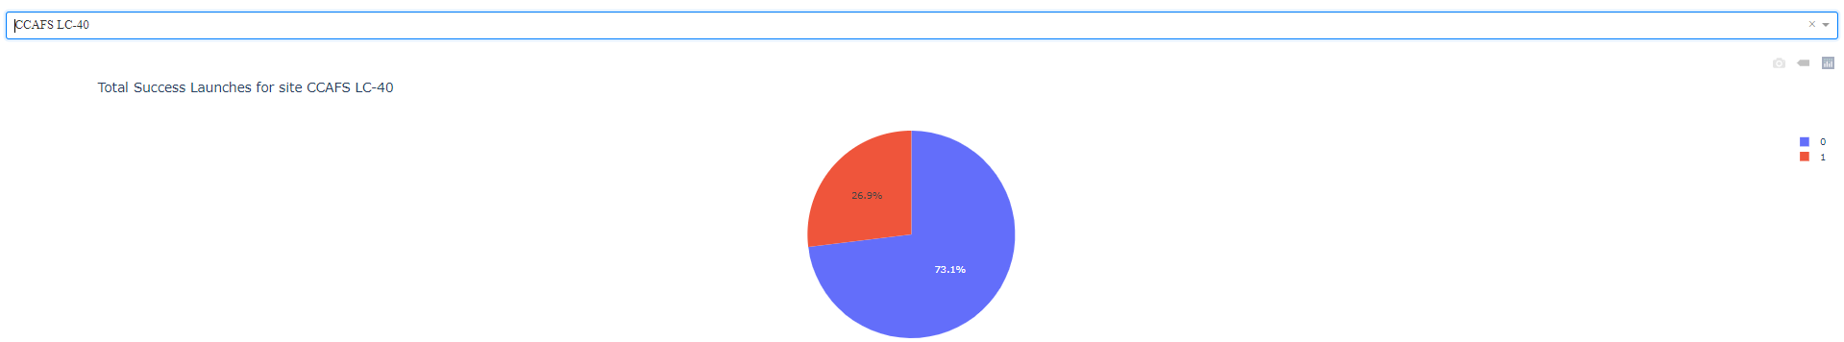
Total Successful Launches for Site CCAFS LC-40
The launch site CCAFS LC-40 has demonstrated a success rate among all SpaceX launch sites, with 73.1% of its total launches being successful.

Slide 41
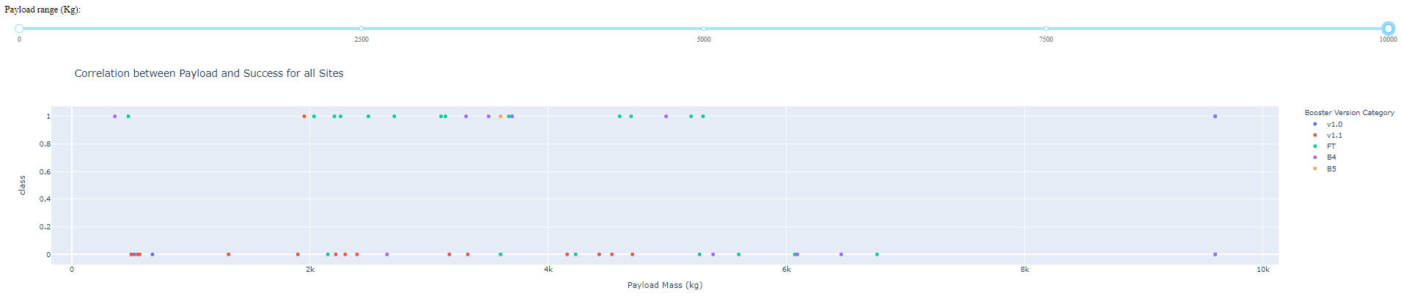
Payload vs Launch Sucess for all Sites
The highest success rate is observed when the payload falls within the range of 2000kg to 4000kg.

Slide 42

Section 5

Slide 43
Classification Accuracy
Visualize the built model accuracy for all built classification models, in a bar chart
Find which model has the highest classification accuracy

Slide 44
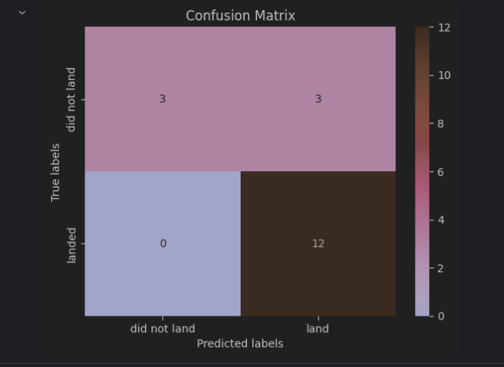
Confusion Matrix

Slide 45
Conclusions
To compete effectively with SpaceX, it’s crucial to understand their strategies for success:
SpaceX strategically locates their launch sites near coastlines and away from populated areas, allowing them to conduct rocket landing tests with minimal disruption.
Among all the launch sites, KSC LC 39A has demonstrated the highest launch success rate.
Since 2015, SpaceX has seen a significant increase in landing success rates. Moreover, a clear trend shows that the success rate improves with an increase in flight numbers.

Slide 46


